Slide 1
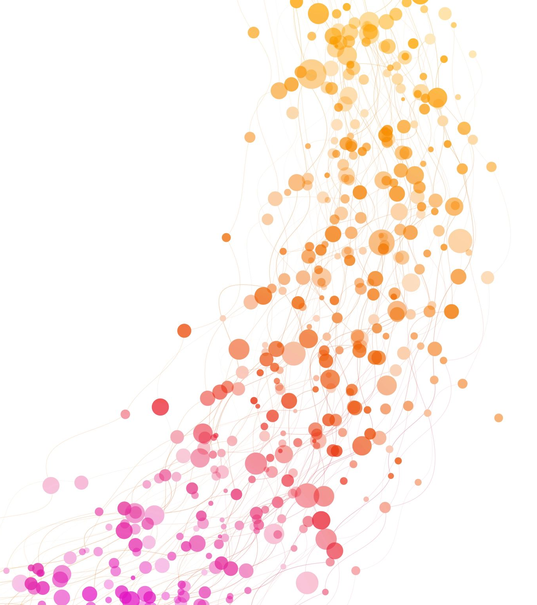
COST- Unit 5
Correlation

Slide 2
Revision
Curve Fitting
Least square Line
Least square parabola
Exponential
Regression

Slide 3

Correlation
Correlation- The degree of relationship between variables.
Measure of how well an equation describes the relationship between two variables.
If all values of the variables satisfy an equation exactly, we say that the variables are perfectly correlated or that there is perfect correlation between them.
Thus, the circumferences C and radii r of all circles are perfectly correlated since $C=2πr$.

Slide 4
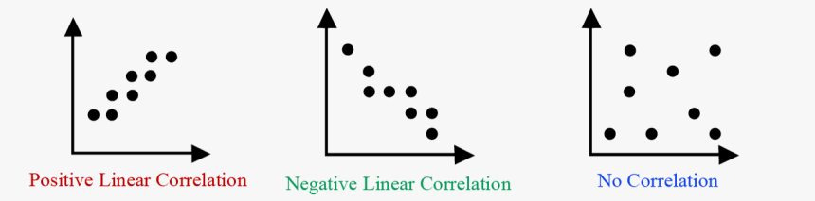
Correlation
If Y tends to increase as X increases, as in Fig (a), the correlation is called positive, or direct correlation.
If Y tends to decrease as X increases, as in Fig. (b), the correlation is called negative, or inverse correlation.
If there is no relationship indicated between the variables, as in Fig. (c), we say that there is no correlation between them i.e., they are uncorrelated.

Slide 5
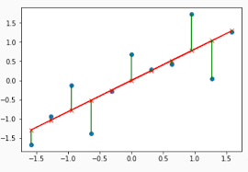

Residuals
A residual is the vertical distance between a data point and the regression line.
Each data point has one residual.
They are positive if they are above the regression line and negative if they are below the regression line.
If the regression line actually passes through the point, the residual at that point is zero.
As residuals are the difference between any data point and the regression line, they are sometimes called “errors.”
Residual = Observed value – predicted value
= $Y−Y_{est}$

Slide 6
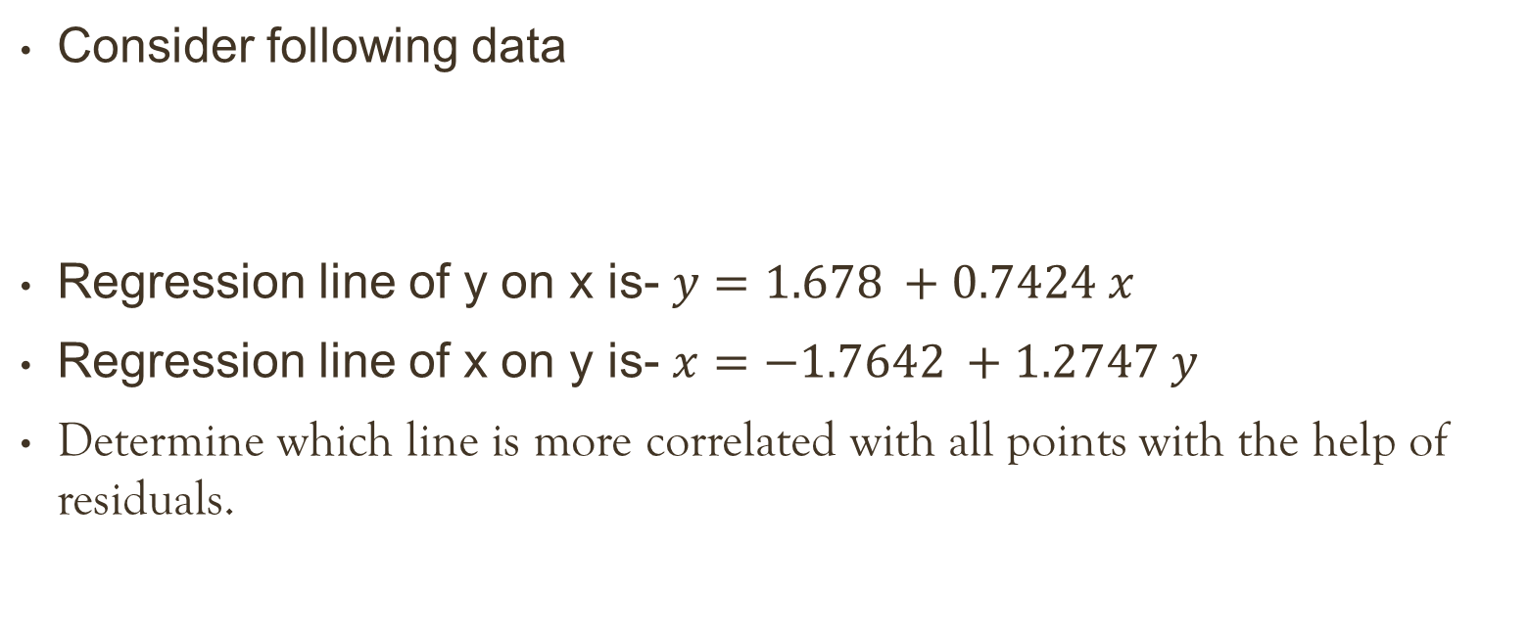
Question
Consider following data
Regression line of y on x is- $y=1.678 +0.7424 x$
Regression line of x on y is- $x=−1.7642 +1.2747 y$
Determine which line is more correlated with all points with the help of residuals.
X | 1 | 3 | 4 | 6 | 8 | 9 | 11 | 14
Y | 2 | 4 | 5 | 6 | 7 | 10 | 9 | 12

Slide 7
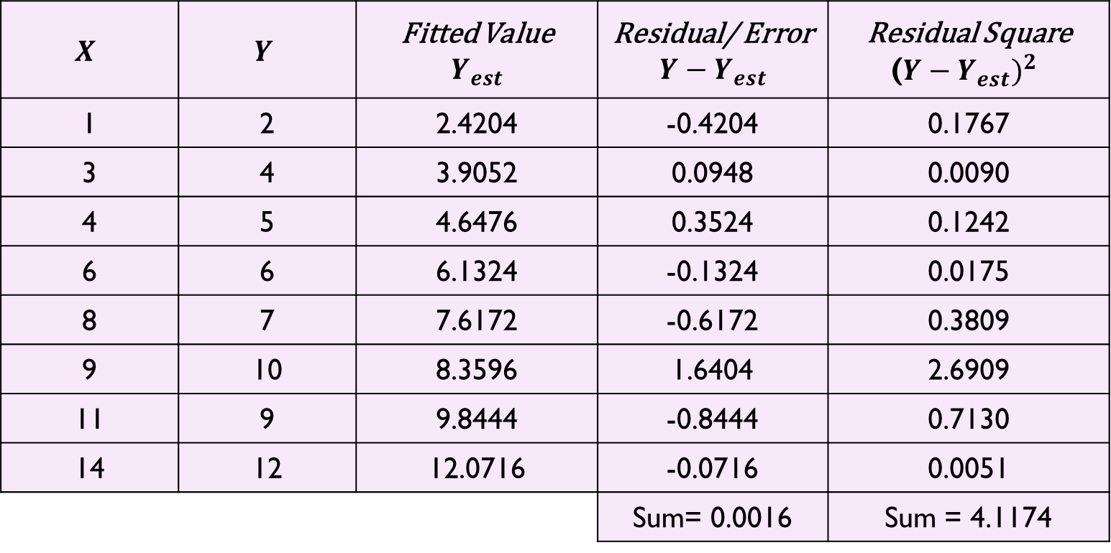

Solution
Regression line of y on x is- $y=1.678 +0.7424 x$
$$X$$ | $$Y$$ | Fitted Value $$Y_{est}$$ | Residual/ Error $$Y−Y_{est}$$ | Residual Square (${Y−Y_{est})}^{2}$
1 | 2 | 2.4204 | -0.4204 | 0.1767
3 | 4 | 3.9052 | 0.0948 | 0.0090
4 | 5 | 4.6476 | 0.3524 | 0.1242
6 | 6 | 6.1324 | -0.1324 | 0.0175
8 | 7 | 7.6172 | -0.6172 | 0.3809
9 | 10 | 8.3596 | 1.6404 | 2.6909
11 | 9 | 9.8444 | -0.8444 | 0.7130
14 | 12 | 12.0716 | -0.0716 | 0.0051
 |  |  | Sum= 0.0016 | Sum = 4.1174

Slide 8


Solution
Regression line of x on y is- $x=−1.7642 +1.2747 y$
$$X$$ | $$Y$$ | Fitted Value $$X_{est}$$ | Residual/ Error $$X−X_{est}$$ | Residual Square (${X−X_{est})}^{2}$
1 | 2 | 0.7842 | 0.2158 | 0.0466
3 | 4 | 3.3326 | -0.3326 | 0.1106
4 | 5 | 4.6068 | -0.6068 | 0.3682
6 | 6 | 5.8810 | 0.1190 | 0.0142
8 | 7 | 7.1552 | 0.8448 | 0.7137
9 | 10 | 10.9778 | -1.9778 | 3.9117
11 | 9 | 9.7036 | 1.2964 | 1.6807
14 | 12 | 13.5262 | 0.4738 | 0.2245
 |  |  | Sum= 0.0326 | Sum= 7.0701

Slide 9
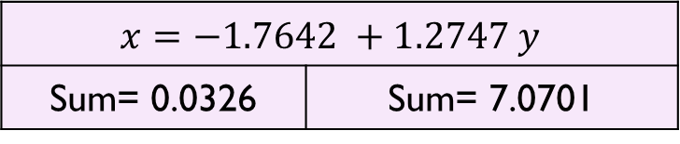
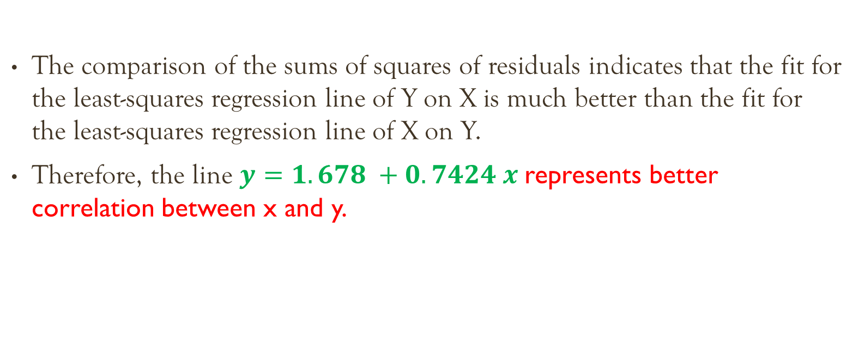
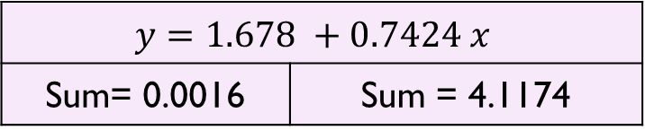
Cont..
$$y=1.678 +0.7424 x$$
Sum= 0.0016 | Sum = 4.1174
$$x=−1.7642 +1.2747 y$$
Sum= 0.0326 | Sum= 7.0701
The comparison of the sums of squares of residuals indicates that the fit for the least-squares regression line of Y on X is much better than the fit for the least-squares regression line of X on Y.
Therefore, the line $y=1.678 +0.7424 x$represents better correlation between x and y.

Slide 10
Question
Consider following data
Regression line of y on x is- y = -0.3333 + 0.7143 x
Regression line of x on y is- x= 1 + 1.2857 y
Determine which line is more correlated with all points with the help of residuals.
X | 3 | 5 | 6 | 8 | 9 | 11
Y | 2 | 3 | 4 | 6 | 5 | 8

Slide 11
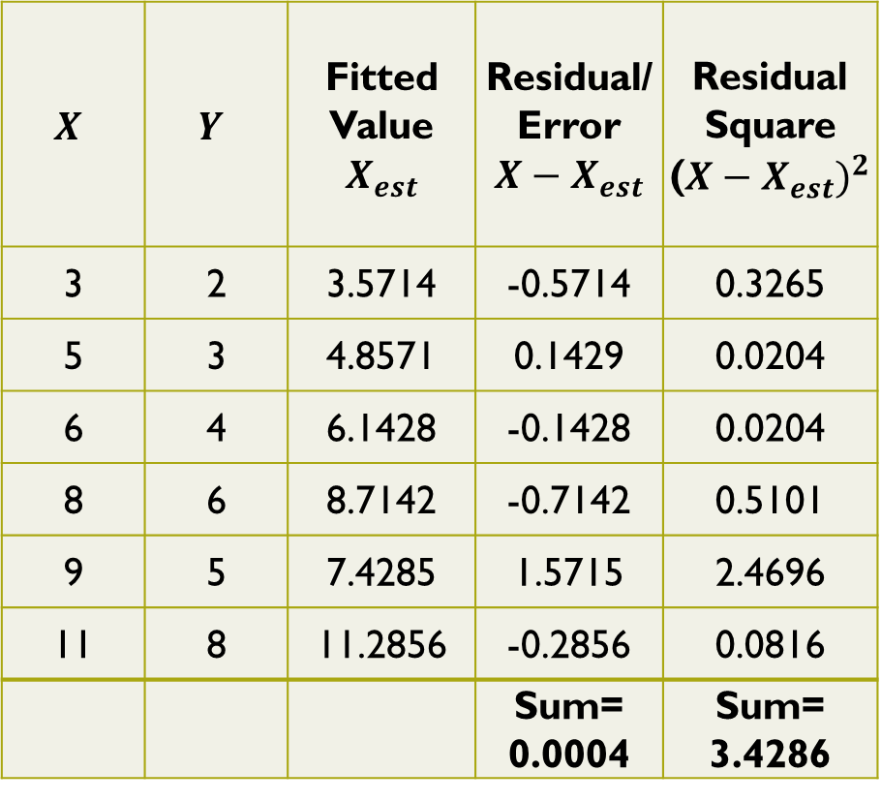
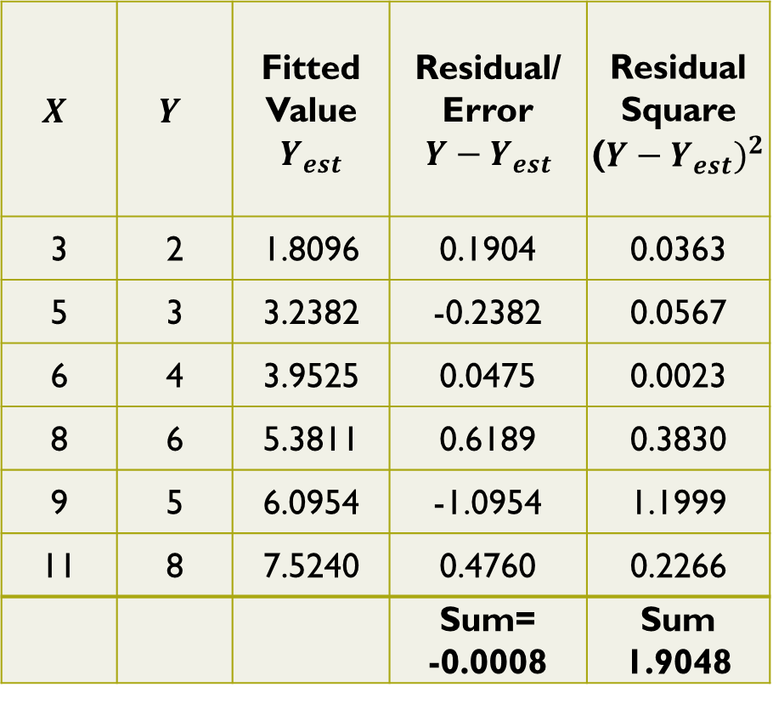
$$X$$ | $$Y$$ | Fitted Value $$Y_{est}$$ | Residual/ Error $$Y−Y_{est}$$ | Residual Square (${Y−Y_{est})}^{2}$
3 | 2 | 1.8096 | 0.1904 | 0.0363
5 | 3 | 3.2382 | -0.2382 | 0.0567
6 | 4 | 3.9525 | 0.0475 | 0.0023
8 | 6 | 5.3811 | 0.6189 | 0.3830
9 | 5 | 6.0954 | -1.0954 | 1.1999
11 | 8 | 7.5240 | 0.4760 | 0.2266
 |  |  | Sum= -0.0008 | Sum 1.9048
$$X$$ | $$Y$$ | Fitted Value $$X_{est}$$ | Residual/ Error $$X−X_{est}$$ | Residual Square (${X−X_{est})}^{2}$
3 | 2 | 3.5714 | -0.5714 | 0.3265
5 | 3 | 4.8571 | 0.1429 | 0.0204
6 | 4 | 6.1428 | -0.1428 | 0.0204
8 | 6 | 8.7142 | -0.7142 | 0.5101
9 | 5 | 7.4285 | 1.5715 | 2.4696
11 | 8 | 11.2856 | -0.2856 | 0.0816
 |  |  | Sum= 0.0004 | Sum= 3.4286
Therefore, the line y = -0.3333 + 0.7143 x represents better correlation between x and y.

Slide 12
Coefficient of correlation
"degree of relationship" between two variables.
Denoted by symbol - ‘r’
The range of r is between -1 and 1, inclusive.
If r = 1, one variable increases if another variable increases.
If r = -1, one variable decreases if another variable increases.
If r = 0, there is no linear relationship between the two variables.

